Slide 1
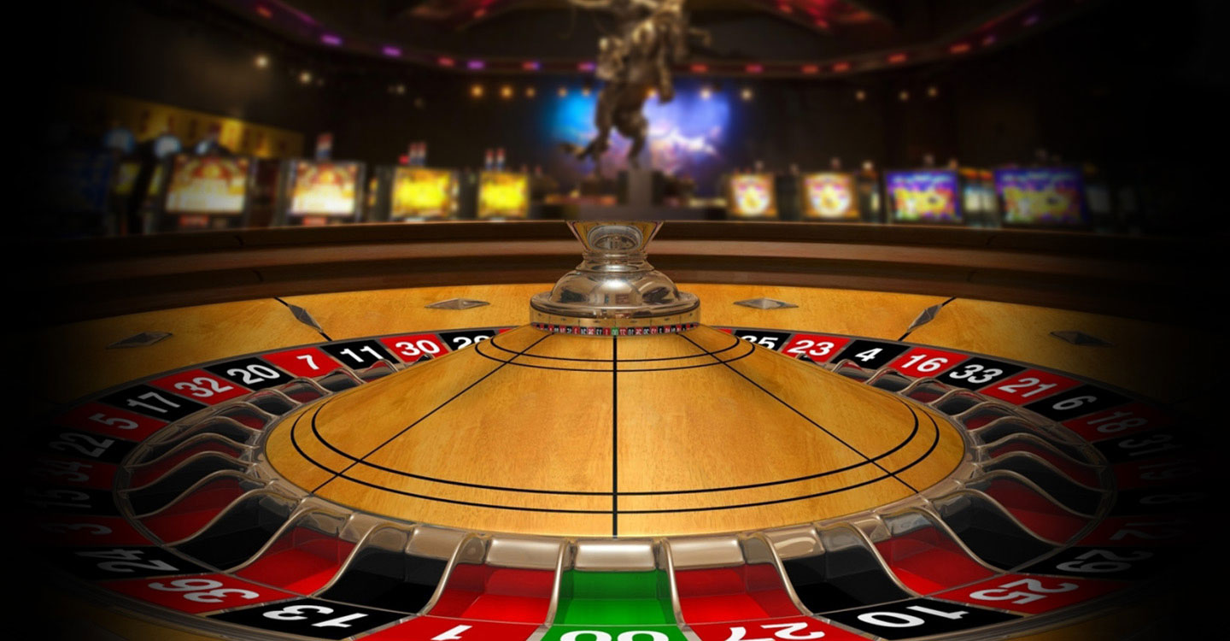
Friday Night Roulette
Are you willing to take a chance on your Friday Night? If the answer is Yes, this app is for you.
Team Members: Lisa Ewart, Steven Sammon, Miki Collins
Link: https://stevensammon.github.io/friday-night/

Slide 2
Application Concept
Application is for users in the Atlanta area to help them plan their evening activities.

Slide 3
Motivation for Development
Provide users with a unique and entertaining way to plan their Friday night.
In the style of a game, the user answers questions that are used as inputs to randomly generate a dining option and an activity option.
Cater to individuals who want to go out or stay at home.
Gambling/casino theme present throughout user experience.

Slide 4
Demo

Slide 5
Design Process
Develop concept
Sketched stages of the game (flow chart, pseudocode, user stories)
Code based on stages of the game
Added features to enhance user experience (suspense, refresh etc.)
Styling and language changes to fit theme

Slide 6
Technologies
Bootstrap
AJAX
APIs – Eatstreet & Edamam
Repeating element - table
User input validation
New Technologies
fadeIn/fadeOut
-webkit-text-fill-color: transparent
@keyframes
Play sound
Radio buttons

Slide 7
Future Development
Increase restaurant/recipe options
Expand service area
Allow user to save experiences through local storage
Add links to activities
App able to pinpoint user location
Add directions to restaurants/activities
Add APIs for activities
Develop cross-browser compatability

Slide 8
Questions?

